Slide 1
Module 15: Cryptographic Services
Instructor Materials
Networking Security v1.0
(NETSEC)
Notes:
Networking Security (NETSEC) Module 15: Cryptographic Services

Slide 2
Module Objectives
Module Title: Cryptographic Services
Module Objective: Explain how the types of encryption, hashes, and digital signatures work together to provide confidentiality, integrity, and authentication.
Topic Title | Topic Objective
Secure Communications | Explain the requirements of secure communications including integrity, authentication, and confidentiality.
Cryptography | Describe cryptography.
Cryptanalysis | Describe cryptanalysis.
Cryptology | Describe cryptology.
Notes:
2
15 – Cryptographic Services
15.0.2 – What will I learn to do in this module?

Slide 3
15.1 Secure Communications
Notes:
15: Cryptographic Services 15.1: Secure Communications

Slide 4
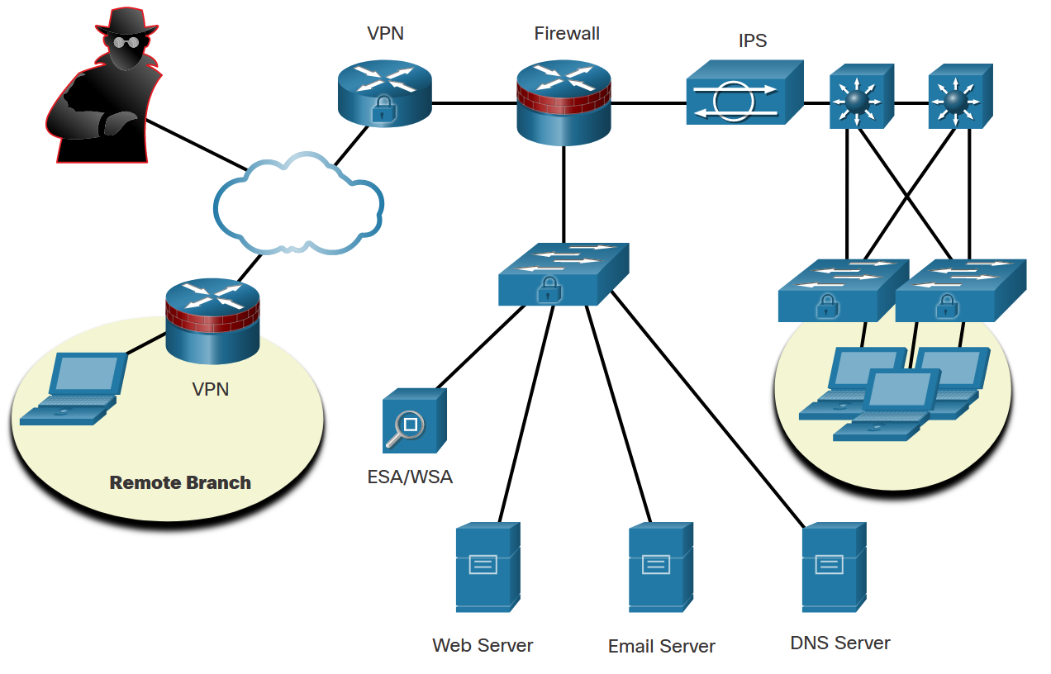
Secure Communications
Confidentiality, Integrity, and Authentication.
To ensure secure communications across both the public and private infrastructure, the network administrator’s first goal is to secure the network infrastructure, including routers, switches, servers, and hosts.
The figure shows an example of a secure network topology.
There are three primary objectives of securing communications:
Confidentiality
Integrity
Authentication
Notes:
15: Cryptographic Services 15.1: Secure Communications 15.1.1: Authentication, Integrity, and Confidentiality

Slide 5
Secure Communications
Authentication
There are two primary methods for validating a source in network communications: authentication services and data nonrepudiation services.
In network communications, authentication services can be accomplished using cryptographic methods.
These services can use various methods such as:
Passwords: A secret string of characters that a user provides to prove their identity.
Two-Factor Authentication (2FA): An additional layer of security where a user is required to provide two different authentication factors to verify themselves.
Biometrics: This involves verifying a user’s identity based on their physical or behavioral characteristics, such as fingerprints, facial recognition, or voice patterns.
Certificates: Digital certificates are used in public key infrastructure (PKI) systems to establish the identity of people and devices over networks.
Multifactor Authentication (MFA): This is a security system that requires more than one method of authentication from independent categories of credentials to verify the user’s identity.
Data nonrepudiation is a similar service that allows the sender of a message to be uniquely identified. With nonrepudiation services in place, a sender cannot deny having been the source of that message.
Notes:
15: Cryptographic Services 15.1: Secure Communications 15.1.2: Authentication

Slide 6
Secure Communications
Data Integrity
Data integrity ensures that messages are not altered in transit. With data integrity, the receiver can verify that the received message is identical to the sent message and that no manipulation occurred.
Notes:
15: Cryptographic Services 15.1: Secure Communications 15.1.3: Data Integrity

Slide 7
Secure Communications
Data Confidentiality
Data confidentiality ensures privacy so that only the receiver can read the message. This can be achieved through encryption. Encryption is the process of scrambling data so that it cannot be easily read by unauthorized parties.
When enabling encryption, readable data is called plaintext, or cleartext, while the encrypted version is called encrypted text or ciphertext. The plaintext readable message is converted to ciphertext, which is the unreadable, disguised message. Decryption reverses the process. A key is required to encrypt and decrypt a message. The key is the link between the plaintext and ciphertext.
Using a hash function is another way to ensure data confidentiality. A hash function transforms a string of characters into a usually shorter, fixed-length value or key that represents the original string. The difference between hashing and encryption is in how the data is stored.
Notes:
15: Cryptographic Services 15.1: Secure Communications 15.1.4: Data Confidentiality
15.1.5: Check Your Understanding - Identify the Secure Communication Objective

Slide 8
15.2 Cryptography
Notes:
15: Cryptographic Services 15.2: Cryptography

Slide 9
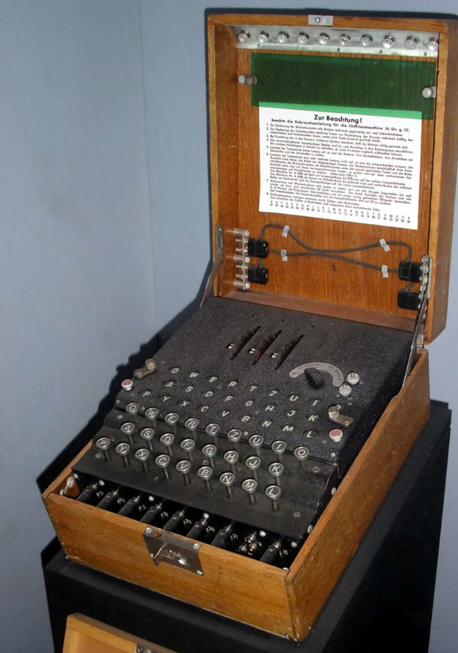
Cryptography
Creating Cipher Text
The history of cryptography starts in diplomatic circles thousands of years ago. Messengers from a king’s court took encrypted messages to other courts. Occasionally, other courts not involved in the communication, attempted to steal messages sent to a kingdom they considered an adversary. Not long after, military commanders started using encryption to secure messages.
The Enigma machine was an electromechanical encryption device that was developed and used by Nazi Germany during World War II. The device depended on the distribution of pre-shared keys that were used to encrypt and decrypt messages. The figure is an example of an Enigma machine.
Notes:
15: Cryptographic Services 15.2: Cryptography 15.2.1: Creating Cipher Text

Slide 10
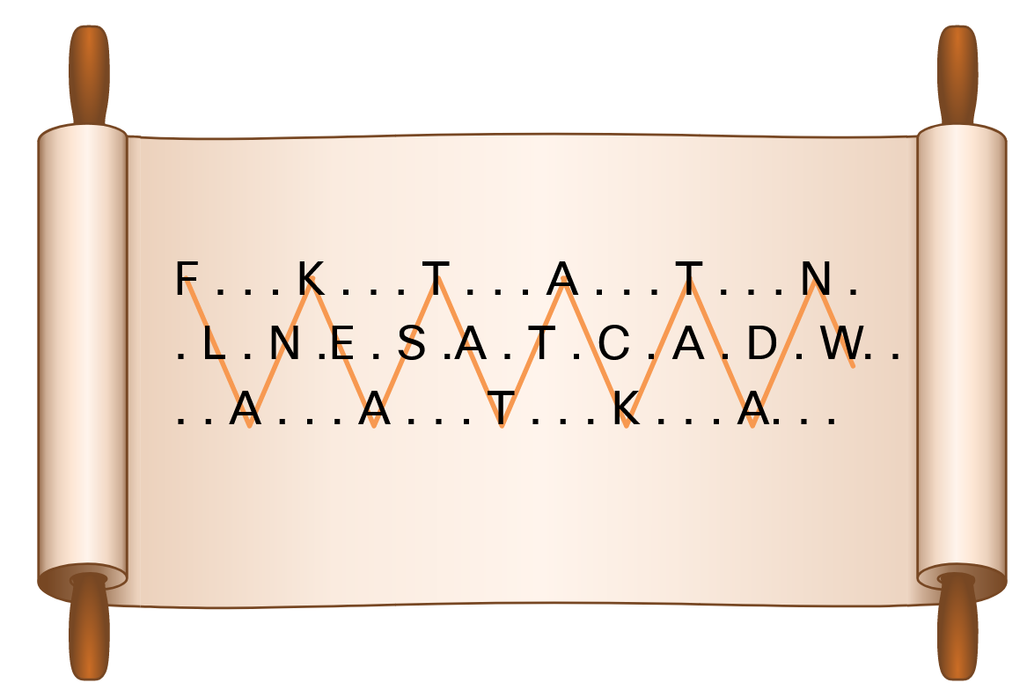
Cryptography
Transposition Ciphers
In transposition ciphers, no letters are replaced; they are simply rearranged. An example of this type of cipher is taking the FLANK EAST ATTACK AT DAWN message and transposing it to read NWAD TA KCATTA TSAE KNALF. In this example, the key is to reverse the letters.
Another example of a transposition cipher is known as the rail fence cipher. In this transposition, the words are spelled out as if they were a rail fence. They are staggered, some in front, some in the middle and some in back, across several parallel lines. An example is shown in the figure.
Modern encryption block cipher algorithms, such as AES and the legacy 3DES, still use transposition as part of the algorithm.
Notes:
15: Cryptographic Services 15.2: Cryptography 15.2.2: Transposition Ciphers

Slide 11
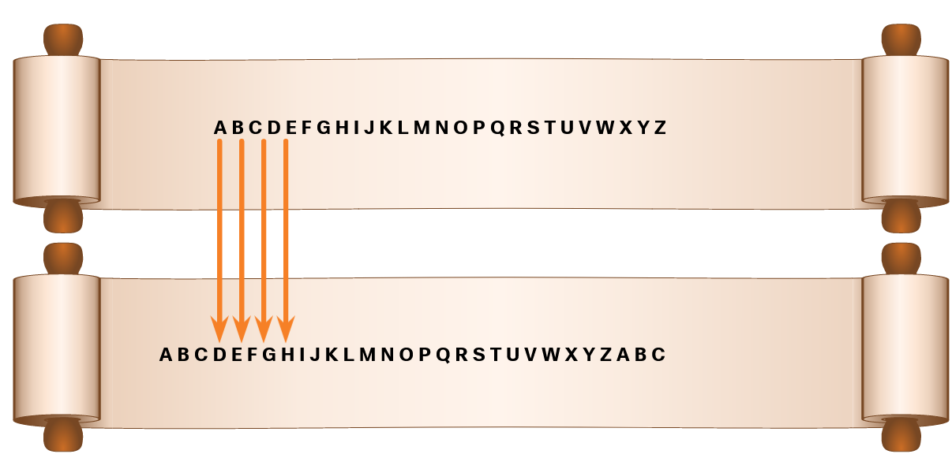
Cryptography
Substitution Ciphers
Substitution ciphers substitute one letter for another. In their simplest form, substitution ciphers retain the letter frequency of the original message.
Notes:
15: Cryptographic Services 15.2: Cryptography 15.2.3: Substitution Ciphers

Slide 12

Cryptography
A More Complex Substitution Cipher
The Vigenère cipher is based on the Caesar cipher, except that it encrypts text by using a different polyalphabetic key shift for every plaintext letter. The different key shift is identified using a shared key between sender and receiver. The plaintext message can be encrypted and decrypted using the Vigenère Cipher Table that is shown in the figure.
Notes:
15: Cryptographic Services 15.2: Cryptography 15.2.4: A More Complex Substitution Cipher

Slide 13

Cryptography
One-Time Pad Ciphers
Gilbert Vernam was an AT&T Bell Labs engineer who, in 1917, invented, and later patented, the stream cipher. He also co-invented the one-time pad cipher. Vernam proposed a teletype cipher in which a prepared key consisting of an arbitrarily long, non-repeating sequence of numbers was kept on paper tape, shown in the figure. It was then combined character by character with the plaintext message to produce the ciphertext.
To decipher the ciphertext, the same paper tape key was again combined character by character, producing the plaintext. Each tape was used only once; hence, the name one-time pad. Several difficulties are inherent in using one-time pads in the real world.
Notes:
15: Cryptographic Services 15.2: Cryptography 15.2.5: One-Time Pad Ciphers

Slide 14
15.3 Cryptanalysis
Notes:
15: Cryptographic Services 15.3: Cryptanalysis

Slide 15
Cryptanalysis
Cracking Code
Cryptanalysis is the practice and study of determining the meaning of encrypted information (cracking the code), without access to the shared secret key. This is also known as codebreaking.
Throughout history, there have been many instances of cryptanalysis:
The Vigenère cipher had been absolutely secure until it was broken in the 19th century by English cryptographer Charles Babbage.
Mary, Queen of Scots, was plotting to overthrow Queen Elizabeth I from the throne and sent encrypted messages to her co-conspirators. The cracking of the code used in this plot led to the beheading of Mary in 1587.
The Enigma-encrypted communications were used by the Germans to navigate and direct their U-boats in the Atlantic. Polish and British cryptanalysts broke the German Enigma code. Winston Churchill was of the opinion that it was a turning point in WWII.
Notes:
15: Cryptographic Services 15.3: Cryptanalysis 15.3.1: Cracking Code

Slide 16
Cryptanalysis
Methods of Cracking Code
Several methods are used in cryptanalysis:
Brute-force method - The attacker tries every possible key knowing that eventually one of them will work.
Ciphertext method - The attacker has the ciphertext of several encrypted messages but no knowledge of the underlying plaintext.
Known-Plaintext method - The attacker has access to the ciphertext of several messages and knows something about the plaintext underlying that ciphertext.
Chosen-Plaintext method - The attacker chooses which data the encryption device encrypts and observes the ciphertext output.
Chosen-Ciphertext method - The attacker can choose different ciphertext to be decrypted and has access to the decrypted plaintext.
Meet-in-the-Middle method - The attacker knows a portion of the plaintext and the corresponding ciphertext.
Notes:
15: Cryptographic Services 15.3: Cryptanalysis 15.3.2: Methods of Cracking Code

Slide 17
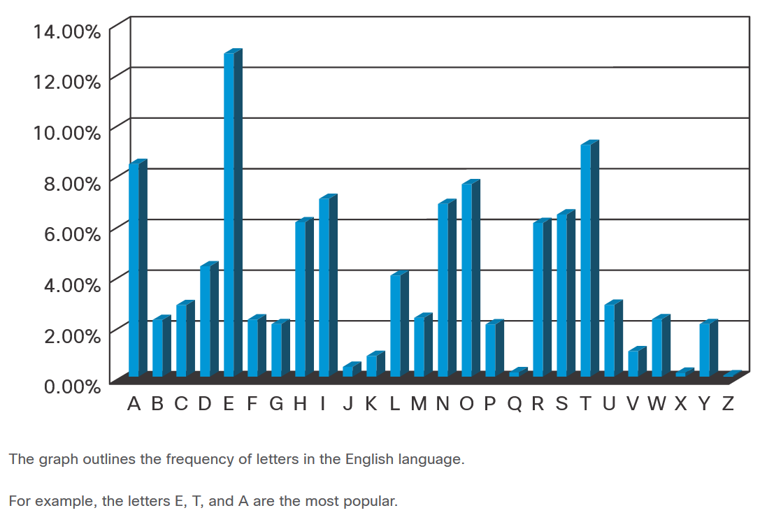
Cryptanalysis
Cracking Code Example
When choosing a cryptanalysis method, consider the Caesar cipher encrypted code. The best way to crack the code is to use brute force. Because there are only 25 possible rotations, the effort is relatively small to try all possible rotations and see which one returns something that makes sense.
A more scientific approach is to use the fact that some characters in the English alphabet are used more often than others. This method is called frequency analysis.
Notes:
15: Cryptographic Services 15.3: Cryptanalysis 15.3.3: Cracking Code Example
15.3.4: Check your Understanding- Crack the Code

Slide 18
15.4 Cryptology
Notes:
15: Cryptographic Services 15.4: Cryptology

Slide 19
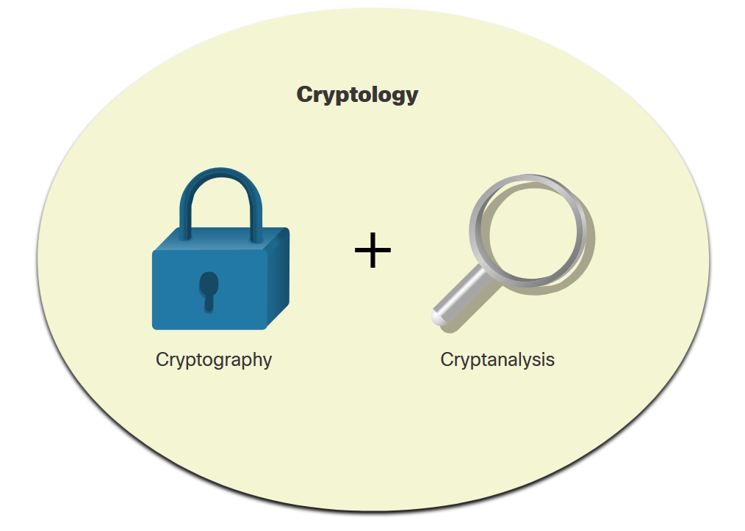
Cryptology
Making and Breaking Secret Codes
Cryptology is the science of making and breaking secret codes. As shown in the figure, cryptology combines two separate disciplines:
Cryptography - the development and use of codes
Cryptanalysis - the breaking of those codes
There is a symbiotic relationship between the two disciplines because each makes the other one stronger. National security organizations employ practitioners of both disciplines and put them to work against each other.
Notes:
15: Cryptographic Services 15.4: Cryptology 15.4.1: Making and Breaking Secret Codes

Slide 20
Cryptology
Cryptanalysts
Cryptanalysis is often used by governments in military and diplomatic surveillance, by enterprises in testing the strength of security procedures, and by malicious hackers in exploiting weaknesses in websites.
Cryptanalysts are individuals who perform cryptanalysis to crack secret codes. A sample job description is displayed in the figure.
While cryptanalysis is often linked to mischievous purposes, it is actually a necessity. It is an ironic fact of cryptography that it is impossible to prove that any algorithm is secure. It can only be proven that it is not vulnerable to known cryptanalytic attacks. Therefore, there is a need for mathematicians, scholars, and security forensic experts to keep trying to break the encryption methods.
Notes:
15: Cryptographic Services 15.4: Cryptology 15.4.2: Cryptanalysts

Slide 21
Cryptology
The Secret is in the Keys
In the world of communications and networking, authentication, integrity, and data confidentiality are implemented in many ways using various protocols and algorithms. The choice of protocol and algorithm varies based on the level of security required to meet the goals of the network security policy.
The table lists some common cryptographic hashes, protocols, and algorithms.
Integrity | Authenticity | Confidentiality
MD5 (legacy) | HMAC-MD5 (legacy) | 3DES (legacy)
SHA | HMAC-SHA-256 | AES
 | RSA and DSA
Notes:
15: Cryptographic Services 15.4: Cryptology 15.4.3: The Secret is in the Keys
15.4.4: Check Your Understanding - Cryptology Terminology

Slide 22
Module 16: Basic Integrity and Authenticity
Instructor Materials
Networking Security v1.0
(NETSEC)
Notes:
Networking Security (NETSEC) Module 16: Basic Integrity and Authenticity

Slide 23
Module Objectives
Module Title: Basic Integrity and Authenticity
Module Objective: Explain how cryptography is used to ensure data integrity and authenticity.
Topic Title | Topic Objective
Integrity and Authenticity | Explain the role of cryptography in ensuring the integrity and authenticity of data.
Key Management | Describe the components of key management.
Confidentiality | Explain how cryptographic approaches enhance data confidentiality.
Notes:
23
Networking Security (NETSEC) Module 16: Basic Integrity and Authenticity

Slide 24
16.1 Integrity and Authenticity
Notes:
16: Basic Integrity and Authenticity 16.1: Integrity and Authenticity

Slide 25
Integrity and Authenticity
Secure Communications
These are the four elements of secure communications:
Data Integrity - Guarantees that the message was not altered. Any changes to data in transit will be detected. Integrity is ensured by implementing either of the Secure Hash Algorithms (SHA-2 or SHA-3). The MD5 message digest algorithm is still widely in use. However, it is inherently insecure and creates vulnerabilities in a network. Note that MD5 should be avoided.
Origin Authentication - Guarantees that the message is not a forgery and does actually come from whom it states. Many modern networks ensure authentication with algorithms such as hash-based message authentication code (HMAC).
Data Confidentiality - Guarantees that only authorized users can read the message. If the message is intercepted, it cannot be deciphered within a reasonable amount of time. Data confidentiality is implemented using symmetric and asymmetric encryption algorithms.
Data Non-Repudiation - Guarantees that the sender cannot repudiate, or refute, the validity of a message sent. Nonrepudiation relies on the fact that only the sender has the unique characteristics or signature for how that message is treated.
Notes:
16: Basic Integrity and Authenticity 16.1: Integrity and Authenticity 16.1.1: Secure Communications

Slide 26
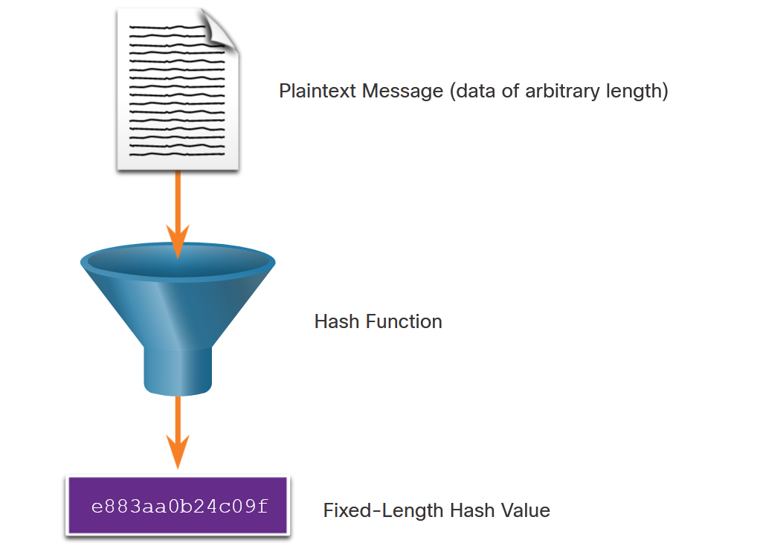
Integrity and Authenticity
Cryptographic Hash Functions
Hashes are used to verify and ensure data integrity. Hashing is based on a one-way mathematical function that is relatively easy to compute, but significantly harder to reverse.
As shown in the figure, a hash function takes a variable block of binary data, called the message, and produces a fixed-length, condensed representation, called the hash. The resulting hash is also sometimes called the message digest, digest, or digital fingerprint.
With hash functions, it is computationally infeasible for two different sets of data to come up with the same hash output. Cryptographic hash values are often called “digital fingerprints”.
Notes:
16: Basic Integrity and Authenticity 16.1: Integrity and Authenticity 16.1.2: Cryptographic Hash Functions

Slide 27
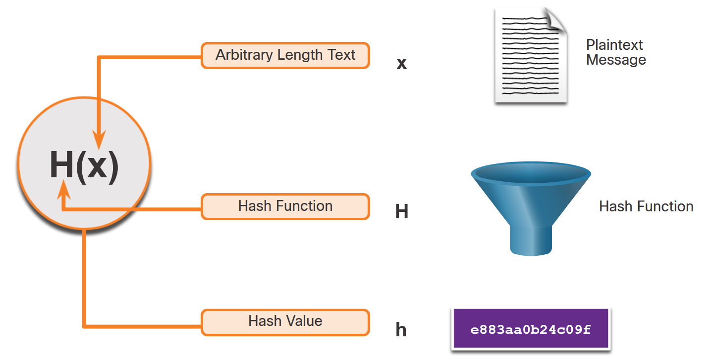
Integrity and Authenticity
Cryptographic Hash Operation
Mathematically, the equation h= H(x) is used to explain how a hash algorithm operates. As shown in the figure, a hash function H takes an input x and returns a fixed-size string hash value h.
The example in the figure summarizes the mathematical process. A cryptographic hash function should have the following properties:
The input can be any length.
The output is always a fixed length.
H(x) is relatively easy to compute for any given x.
H(x) is one way and not reversible.
H(x) is collision free, meaning that two different input values will result in different hash values.
Notes:
16: Basic Integrity and Authenticity 16.1: Integrity and Authenticity 16.1.3: Cryptographic Hash Operation

Slide 28
Integrity and Authenticity
MD5 and SHA
Hash functions are used to ensure the integrity of a message. They help ensure data has not accidentally changed and that what was sent is indeed what was received.
There are four well-known hash functions:
MD5 with 128-bit digest
SHA-1 with 160-bit digest
SHA-2 with 224-256-bit digest
SHA-3 with 224-512-bit digest
While hashing can be used to detect accidental changes, it cannot be used to guard against deliberate changes that are made by a threat actor. Therefore, hashing is vulnerable to man-in-the-middle attacks and does not provide security to transmitted data. To provide integrity against man-in-the-middle attacks, origin authentication is also required.
Notes:
16: Basic Integrity and Authenticity 16.1: Integrity and Authenticity 16.1.4: MD5 and SHA

Slide 29
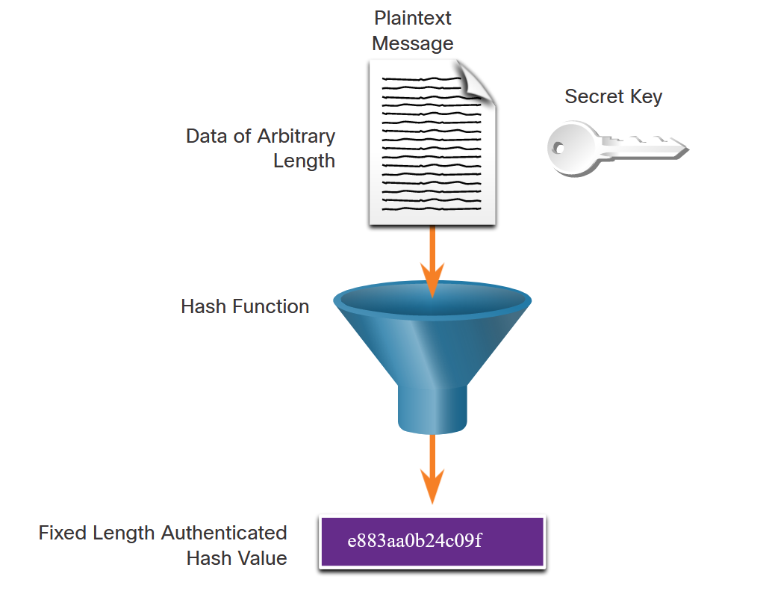
Integrity and Authenticity
Origin Authentication
To add origin authentication and integrity assurance, use a keyed-hash message authentication code (HMAC). HMAC uses an additional secret key as input to the hash function.
As shown in the figure, an HMAC is calculated using any cryptographic algorithm that combines a cryptographic hash function with a secret key. Hash functions are the basis of the protection mechanism of HMACs.
Only the sender and the receiver know the secret key, and the output of the hash function now depends on the input data and the secret key. Only parties who have access to that secret key can compute the digest of an HMAC function. This defeats man-in-the-middle attacks and provides authentication of the data origin.
Notes:
16: Basic Integrity and Authenticity 16.1: Integrity and Authenticity 16.1.5: Origin Authentication

Slide 30
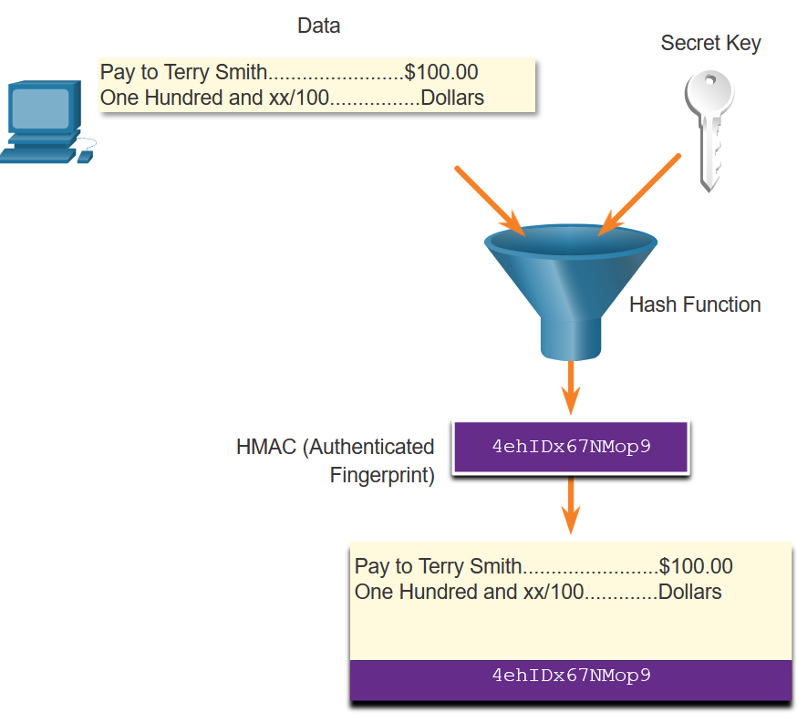
Integrity and Authenticity
Origin Authentication (Cont.)
As shown in the figure, the sending device inputs data (such as Terry Smith’s pay of $100 and the secret key) into the hashing algorithm and calculates the fixed-length HMAC digest. This authenticated digest is then attached to the message and sent to the receiver.
Notes:
16: Basic Integrity and Authenticity 16.1: Integrity and Authenticity 16.1.5: Origin Authentication

Slide 31
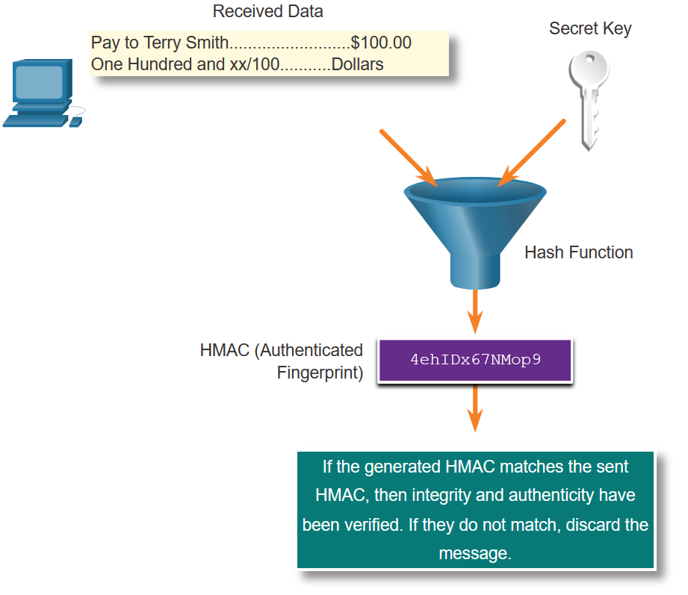
Integrity and Authenticity
Origin Authentication (Cont.)
In the figure, the receiving device removes the digest from the message and uses the plaintext message with its secret key as input into the same hashing function. If the digest that is calculated by the receiving device is equal to the digest that was sent, the message has not been altered. Additionally, the origin of the message is authenticated because only the sender possesses a copy of the shared secret key. The HMAC function has ensured the authenticity of the message.
Notes:
16: Basic Integrity and Authenticity 16.1: Integrity and Authenticity 16.1.5: Origin Authentication

Slide 32
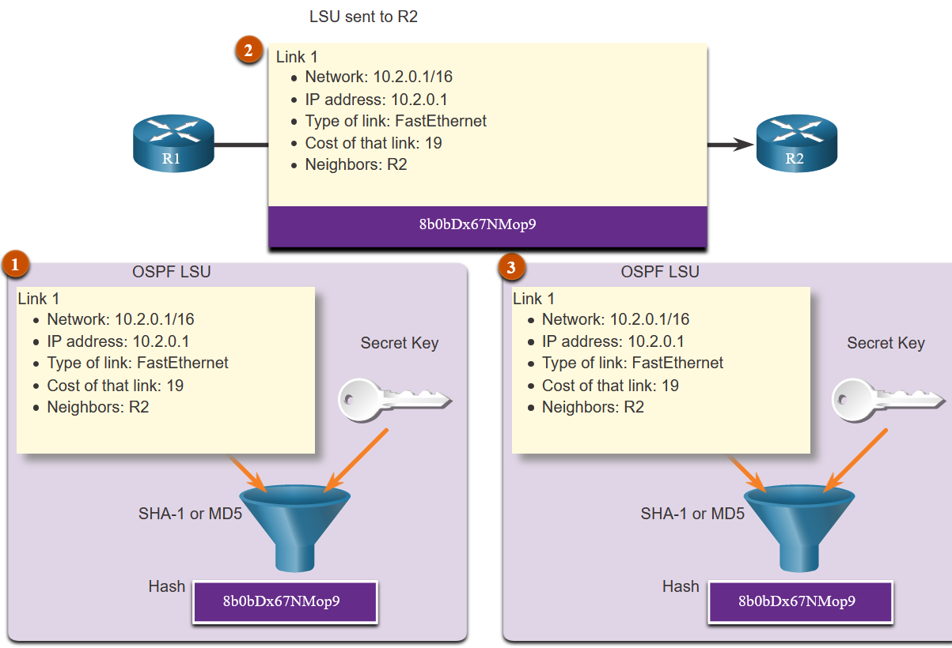
Integrity and Authenticity
Origin Authentication (Cont.)
The figure shows how HMACs are used by Cisco routers that are configured to use Open Shortest Path First (OSPF) routing authentication.
R1 is sending a link state update (LSU) regarding a route to network 10.2.0.0/16:
R1 calculates the hash value using the LSU message and the secret key.
The resulting hash value is sent with the LSU to R2.
R2 calculates the hash value using the LSU and its secret key. R2 accepts the update if the hash values match. If they do not match, R2 discards the update.
Notes:
16: Basic Integrity and Authenticity 16.1: Integrity and Authenticity 16.1.5: Origin Authentication

Slide 33
16.2 Key Management
Notes:
16: Basic Integrity and Authenticity 16.2: Key Management

Slide 34
Key Management
Characteristics of Key Management
Key management is often considered the most difficult part of designing a cryptosystem. As shown in the table, there are several essential characteristics of key management to consider.
Characteristic | Description
Key Generation | It was up to Caesar to choose the key of his cipher. The Vigenère cipher key is also chosen by the sender and receiver. In a modern cryptographic system, key generation is usually automated and not left to the end user. The use of good random number generators is needed to ensure that all keys are equally generated so that the attacker cannot predict which keys are more likely to be used.
Key Verification | Some keys are better than others. Almost all cryptographic algorithms have some weak keys that should not be used. With the help of key verification procedures, weak keys can be identified and regenerated to provide a more secure encryption. With the Caesar cipher, using a key of 0 or 25 does not encrypt the message, so it should not be used.
Key Exchange | Key management procedures should provide a secure key exchange mechanism that allows secure agreement on the keying material with the other party, probably over an untrusted medium.
Key Storage | On a modern multi-user operating system that uses cryptography, a key can be stored in memory. This presents a possible problem when that memory is swapped to the disk, because a Trojan horse program installed on the PC of a user could then have access to the private keys of that user.
Key Lifetime | Using short key lifetimes improves the security of legacy ciphers that are used on high-speed connections. In IPsec a 24-hour lifetime is typical. However, changing the lifetime to 30 minutes improves the security of the algorithms.
Key Revocation and Destruction | Revocation notifies all interested parties that a certain key has been compromised and should no longer be used. Destruction erases old keys in a manner that prevents malicious attackers from recovering them.
Notes:
16: Basic Integrity and Authenticity 16.2: Key Management 16.2.1: Characteristics of Key Management

Slide 35
Key Management
Key Length and Keyspace
Two terms that are used to describe keys are:
Key length - Also called the key size, this is the measure in bits. In this course, we will use the term key length.
Keyspace - This is the number of possibilities that can be generated by a specific key length.
As key length increases, the keyspace increases exponentially. The table displays the characteristics of the AES encryption algorithm.
AES Characteristics Description | Advanced Encryption Standard
Timeline | Official standard since 2001
Type of Algorithm | Symmetric
Key Size (in bits) | 128, 192, and 256
Speed | High
Time to Crack(assuming a computer could try 255 keys per second) | 149 trillion years
Resource Consumption | Low
Notes:
16: Basic Integrity and Authenticity 16.2: Key Management 16.2.2: Key Length and Keyspace

Slide 36
Key Management
The Keyspace
The keyspace of an algorithm is the set of all possible key values. A key that has n bits produces a keyspace that has 2^{n} possible key values. By adding one bit to the key, the keyspace is effectively doubled.
Almost every algorithm has some weak keys in its keyspace that enable an attacker to break the encryption via a shortcut. Weak keys show the regularities in encryption. For instance, DES has four keys for which encryption is the same as decryption. This means that if one of these weak keys is used to encrypt plaintext, an attacker can use the weak key to decrypt the ciphertext and reveal the plaintext.
The DES weak keys are those that produce 16 identical subkeys. This occurs when the key bits are:
Alternating ones and zeros (0101010101010101)
Alternating F and E (FEFEFEFEFEFEFEFE)
E0E0E0E0F1F1F1F1
1F1F1F1F0E0E0E0E
Notes:
16: Basic Integrity and Authenticity 16.2: Key Management 16.2.3: The Keyspace

Slide 37
Key Management
Types of Cryptographic Keys
Current key lengths can easily make any attack attempt insignificant because it takes millions or billions of years to complete the search when a sufficiently long key is used.
With modern algorithms that are trusted, the strength of protection depends solely on the size of the key. Choose the key length so that it protects data confidentiality or integrity for an adequate period of time. Data that is more sensitive and needs to be kept secret longer must use longer keys.
Length of Protection | Symmetric Key | Asymmetric Key | Digital Signature | Hash
3 years | 80 | 1248 | 160 | 160
10 years | 96 | 1776 | 192 | 192
20 years | 112 | 2432 | 224 | 224
30 years | 128 | 3248 | 256 | 256
Protection against quantum computers | 256 | 15424 | 512 | 512
Notes:
16: Basic Integrity and Authenticity 16.2: Key Management 16.2.4: Types of Cryptographic Keys

Slide 38
Key Management
Choice of Cryptographic Keys
Performance is another issue that can influence the choice of a key length. An administrator must find a good balance between the speed and protective strength of an algorithm, because some algorithms, such as the Rivest, Shamir, and Adleman (RSA) algorithm, run slowly due to large key lengths.
The estimated funding of the attacker should also affect the choice of key length.
The rule “the longer the key, the better” is valid, except for possible performance reasons. Shorter keys equal faster processing but are less secure. Longer keys equal slower processing but are more secure.
Notes:
16: Basic Integrity and Authenticity 16.2: Key Management 16.2.5: Choice of Cryptographic Keys
16.2.6: Check Your Understanding - Characteristics of Key Management

Slide 39
16.3 Confidentiality
Notes:
16: Basic Integrity and Authenticity 16.3: Confidentiality

Slide 40
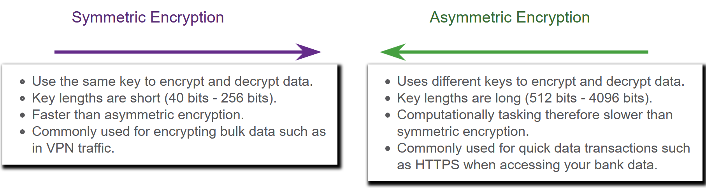
Confidentiality
Data Confidentiality
Symmetric encryption algorithms such as Data Encryption Standard (DES), 3DES, and Advanced Encryption Standard (AES) are based on the premise that each communicating party knows the pre-shared key.
Data confidentiality can also be ensured using asymmetric algorithms, including Rivest, Shamir, and Adleman (RSA) and the public key infrastructure (PKI).
The figure highlights some differences between symmetric and asymmetric encryption
Notes:
16: Basic Integrity and Authenticity 16.3: Confidentiality 16.3.1: Data Confidentiality

Slide 41
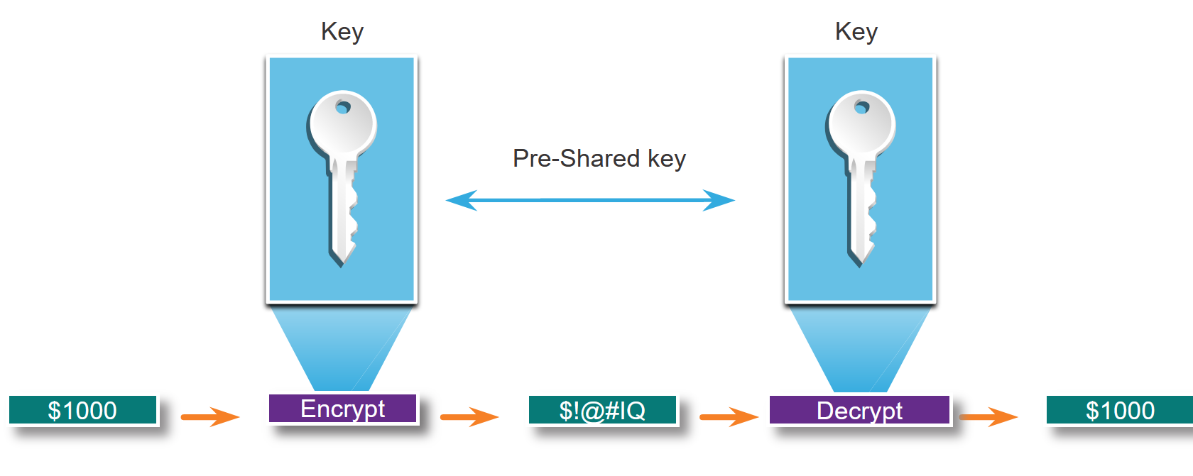
Confidentiality
Symmetric Encryption
Symmetric algorithms use the same pre-shared key to encrypt and decrypt data. A pre-shared key, also called a secret key, is known by the sender and receiver before any encrypted communications can take place.
In the figure, Alice and Bob have identical keys to a single padlock. These keys were exchanged prior to sending any secret messages. Alice writes a secret message and puts it in a small box that she locks using the padlock with her key. She mails the box to Bob. The message is safely locked inside the box as the box makes its way through the post office system. When Bob receives the box, he uses his key to unlock the padlock and retrieve the message. Bob can use the same box and padlock to send a secret reply back to Alice.
Notes:
16: Basic Integrity and Authenticity 16.3: Confidentiality 16.3.2: Symmetric Encryption

Slide 42
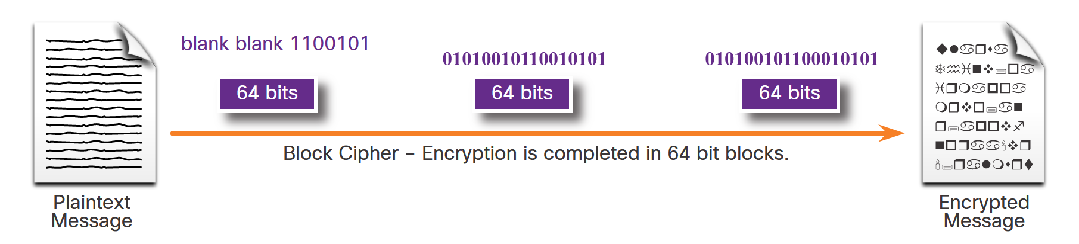
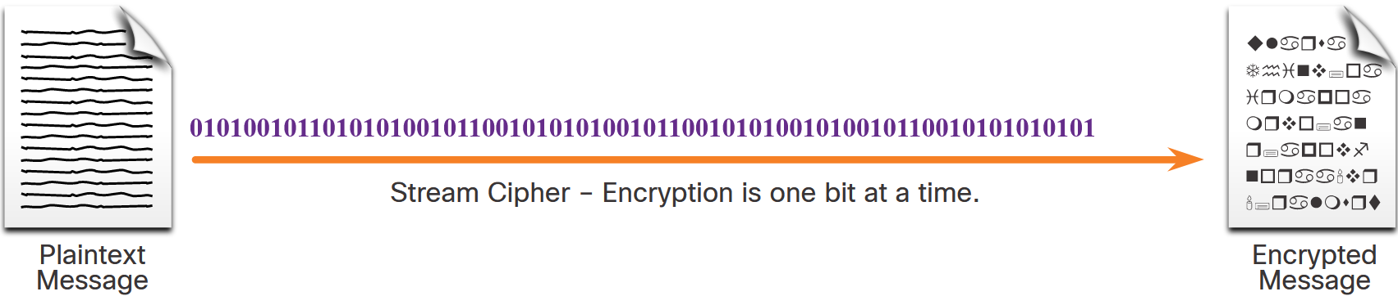
Confidentiality
Symmetric Encryption (Cont.)
Symmetric encryption algorithms are sometimes classified as either a block cipher or a stream cipher.
Block ciphers transform a fixed-length block of plaintext into a common block of ciphertext of 64 or 128 bits. Common block ciphers include DES with a 64-bit block size and AES with a 128-bit block size.
Stream ciphers encrypt plaintext one byte or one bit at a time. Stream ciphers are basically a block cipher with a block size of one byte or bit. Stream ciphers are typically faster than block ciphers because data is continuously encrypted.
Notes:
16: Basic Integrity and Authenticity 16.3: Confidentiality 16.3.2: Symmetric Encryption

Slide 43
Confidentiality
Symmetric Encryption (Cont.)
Well-known symmetric encryption algorithms are described in the table.
Symmetric Encryption Algorithms | Description
Data Encryption Standard (DES) | This is a legacy symmetric encryption algorithm. It uses a short key length that makes it insecure for most current uses.
3DES (Triple DES) | The is the replacement for DES and repeats the DES algorithm process three times. It should be avoided if possible as it is scheduled to be retired in 2023. If implemented, use very short key lifetimes.
Advanced Encryption Standard (AES) | AES is a popular and recommended symmetric encryption algorithm. It offers combinations of 128-, 192-, or 256-bit keys to encrypt 128, 192, or 256 bit-long data blocks.
Software-Optimized Encryption Algorithm (SEAL) | SEAL is a faster alternative symmetric encryption algorithm to AES. SEAL is a stream cypher that uses a 160-bit encryption key and has a lower impact on the CPU compared to other software-based algorithms.
Rivest ciphers (RC) series algorithms | This algorithm was developed by Ron Rivest. Several variations have been developed, but RC4 was the most prevalent in use. RC4 is a stream cipher that was used to secure web traffic. It has been found to have multiple vulnerabilities which have made it insecure. RC4 should not be used. Use RC6 instead.
Notes:
16: Basic Integrity and Authenticity 16.3: Confidentiality 16.3.2: Symmetric Encryption

Slide 44
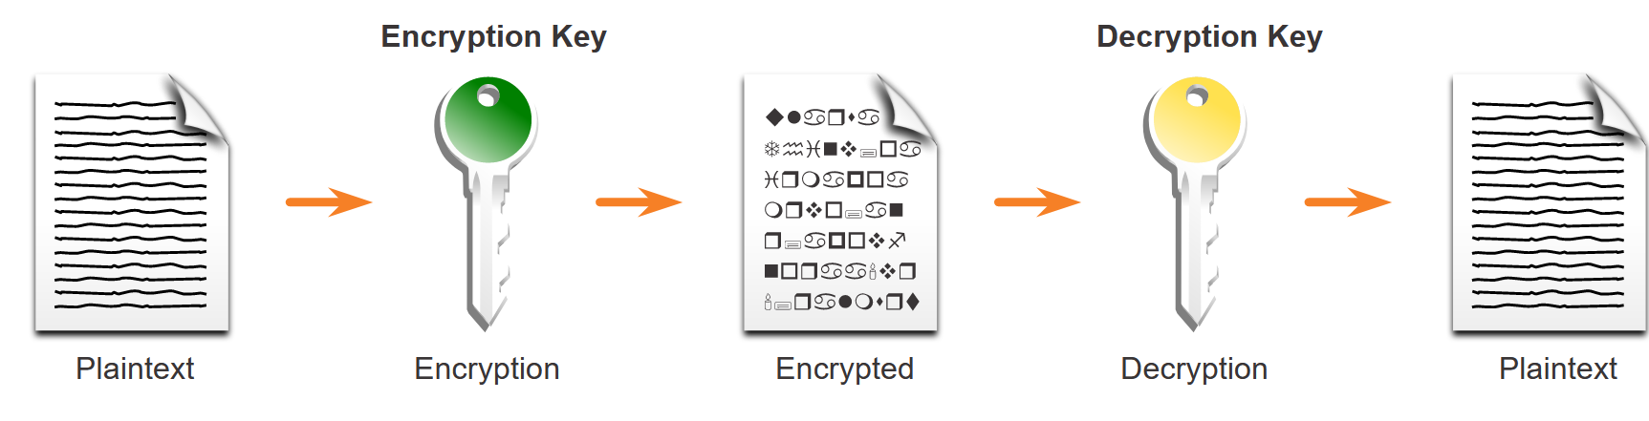
Confidentiality
Asymmetric Encryption
Asymmetric algorithms, also called public-key algorithms, are designed so that the key that is used for encryption is different from the key that is used for decryption, as shown in the figure. The decryption key cannot, in any reasonable amount of time, be calculated from the encryption key and vice versa.
Examples of protocols that use asymmetric key algorithms include:
Internet Key Exchange (IKE) - This is a fundamental component of IPsec VPNs.
Secure Socket Layer (SSL) - This is now implemented as IETF standard Transport Layer Security (TLS).
Secure Shell (SSH) - This protocol provides a secure remote access connection to network devices.
Pretty Good Privacy (PGP) - This computer program provides cryptographic privacy and authentication. It is often used to increase the security of email communications.
Notes:
16: Basic Integrity and Authenticity 16.3: Confidentiality 16.3.3: Asymmetric Encryption

Slide 45
Confidentiality
Asymmetric Encryption (Cont.)
Asymmetric Encryption Algorithm | Key Length | Description
Diffie-Hellman (DH) | 512, 1024, 2048, 3072, 4096 | The Diffie-Hellman algorithm allows two parties to agree on a key that they can use to encrypt messages they want to send to each other. The security of this algorithm depends on the assumption that it is easy to raise a number to a certain power, but difficult to compute which power was used given the number and the outcome.
Digital Signature Standard (DSS) and Digital Signature Algorithm (DSA) | 512 - 1024 | DSS specifies DSA as the algorithm for digital signatures. DSA is a public key algorithm based on the ElGamal signature scheme. Signature creation speed is similar to RSA, but is 10 to 40 times slower for verification.
Rivest, Shamir, and Adleman encryption algorithms (RSA) | 512 to 2048 | RSA is for public-key cryptography that is based on the current difficulty of factoring very large numbers. It is the first algorithm known to be suitable for signing, as well as encryption. It is widely used in electronic commerce protocols and is believed to be secure given sufficiently long keys and the use of up-to-date implementations.
EIGamal | 512 - 1024 | An asymmetric key encryption algorithm for public-key cryptography which is based on the Diffie-Hellman key agreement. A disadvantage of the ElGamal system is that the encrypted message becomes very big, about twice the size of the original message and for this reason it is only used for small messages such as secret keys.
Elliptic curve techniques | 224 or higher | Elliptic curve cryptography can be used to adapt many cryptographic algorithms, such as Diffie-Hellman or ElGamal. The main advantage of elliptic curve cryptography is that the keys can be much smaller.
Notes:
16: Basic Integrity and Authenticity 16.3: Confidentiality 16.3.3: Asymmetric Encryption

Slide 46
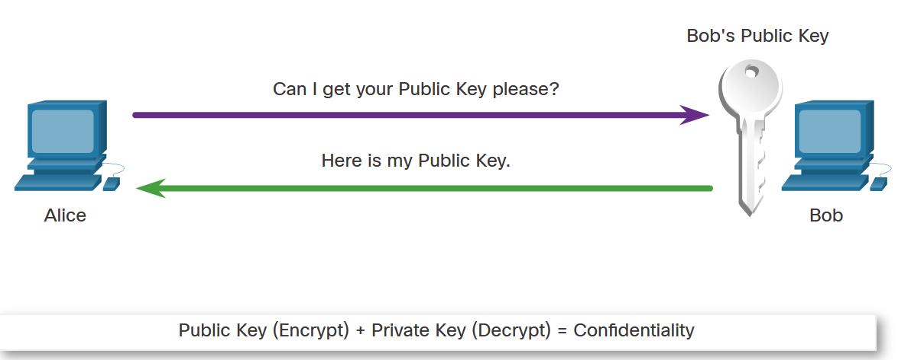
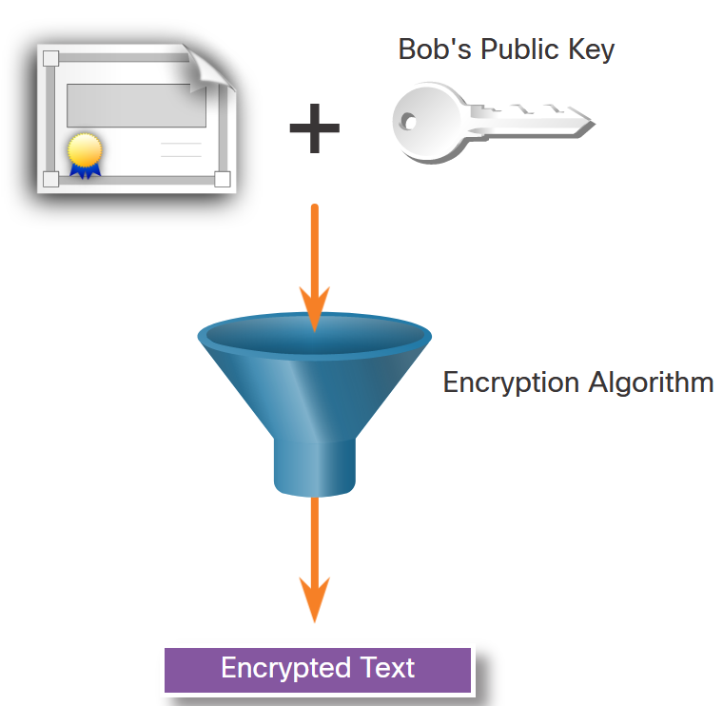
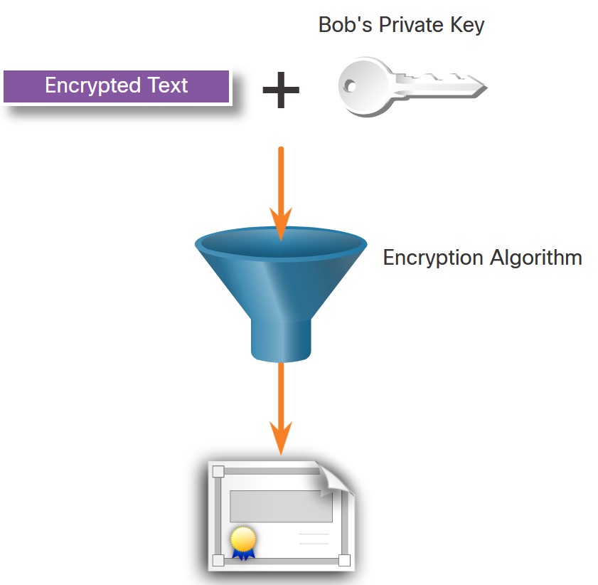
Confidentiality
Asymmetric Encryption - Confidentiality
The process can be summarized using the formula:
Public Key (Encrypt) + Private Key (Decrypt) = Confidentiality
When the public key is used to encrypt the data, the private key must be used to decrypt the data. Only one host has the private key; therefore, confidentiality is achieved.
Alice requests and obtains Bob’s public key.
Alice uses Bob’s public key to encrypt a message using an agreed-upon algorithm. Alice sends the encrypted message to Bob.
Bob then uses his private key to decrypt the message. Since Bob is the only one with the private key, Alice's message can only be decrypted by Bob and thus confidentiality is achieved.
Notes:
16: Basic Integrity and Authenticity 16.3: Confidentiality 16.3.4: Asymmetric Encryption - Confidentiality

Slide 47
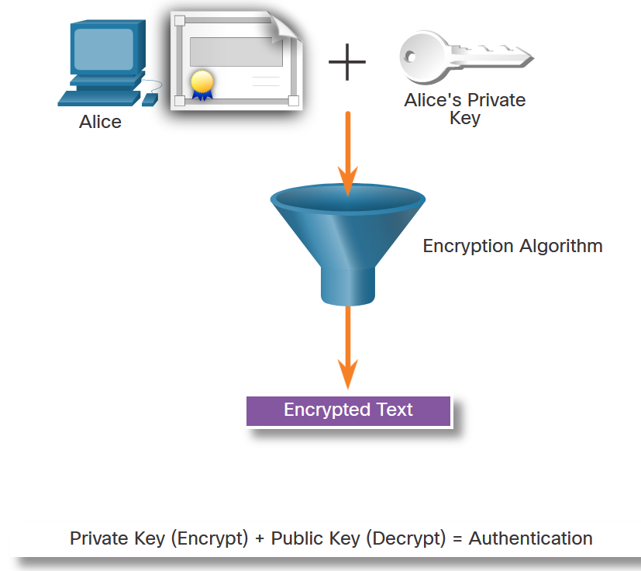
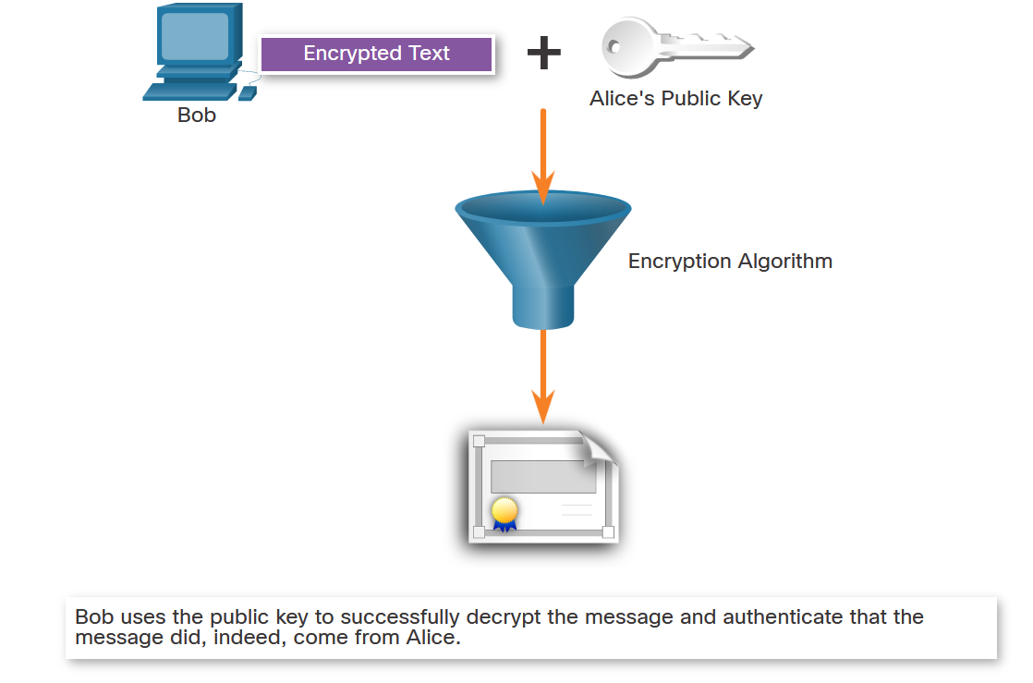
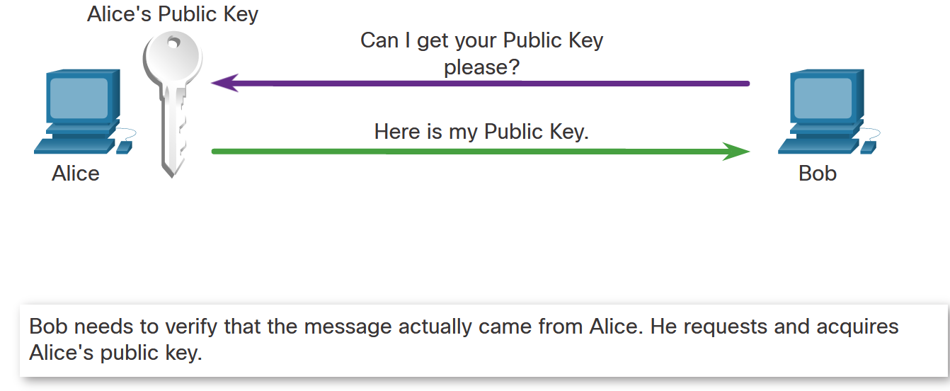
Confidentiality
Asymmetric Encryption - Authentication
The authentication objective of asymmetric algorithms is initiated when the encryption process is started with the private key.
The process can be summarized using the formula:
Private Key (Encrypt) + Public Key (Decrypt) = Authentication
Alice encrypts a message using her private key. Alice sends the encrypted message to Bob. Bob needs to authenticate that the message did indeed come from Alice.
In order to authenticate the message, Bob requests Alice’s public key.
Bob uses Alice’s public key to decrypt the message.
Notes:
16: Basic Integrity and Authenticity 16.3: Confidentiality 16.3.5: Asymmetric Encryption - Authentication

Slide 48
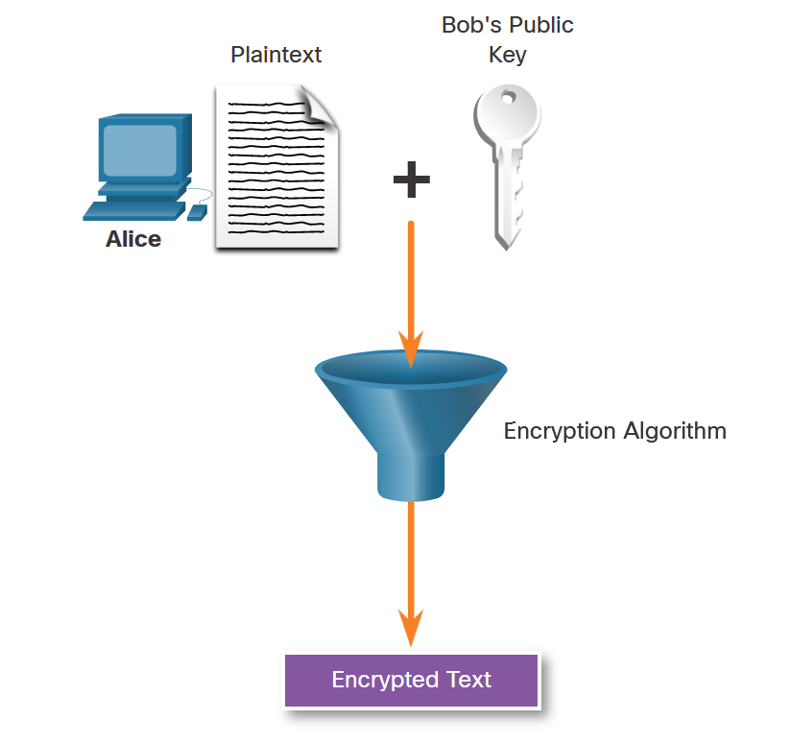
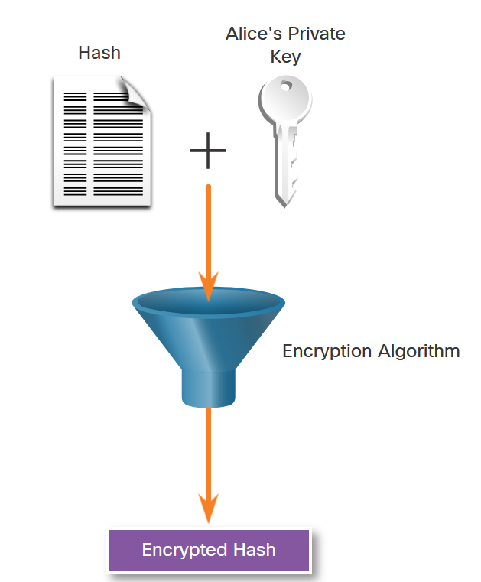
Confidentiality
Asymmetric Encryption - Integrity
Combining the two asymmetric encryption processes provides message confidentiality, authentication, and integrity. The following example will be used to illustrate this process. In this example, a message will be ciphered using Bob’s public key and a ciphered hash will be encrypted using Alice’s private key to provide confidentiality, authenticity, and integrity.
Alice wants to send a message to Bob ensuring that only Bob can read the document. In other words, Alice wants to ensure message confidentiality. Alice uses the public key of Bob to cipher the message. Only Bob will be able to decipher it using his private key
Alice also wants to ensure message authentication and integrity. Authentication ensures Bob that the document was sent by Alice, and integrity ensures that it was not modified Alice uses her private key to cipher a hash of the message. Alice sends the encrypted message with its encrypted hash to Bob.
Notes:
16: Basic Integrity and Authenticity 16.3: Confidentiality 16.3.6: Asymmetric Encryption - Integrity

Slide 49
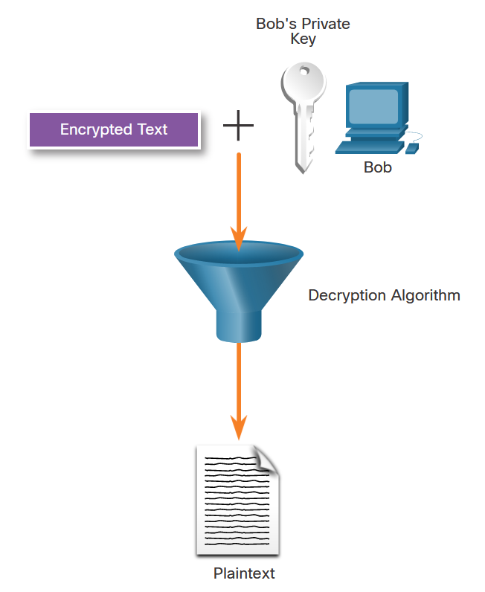
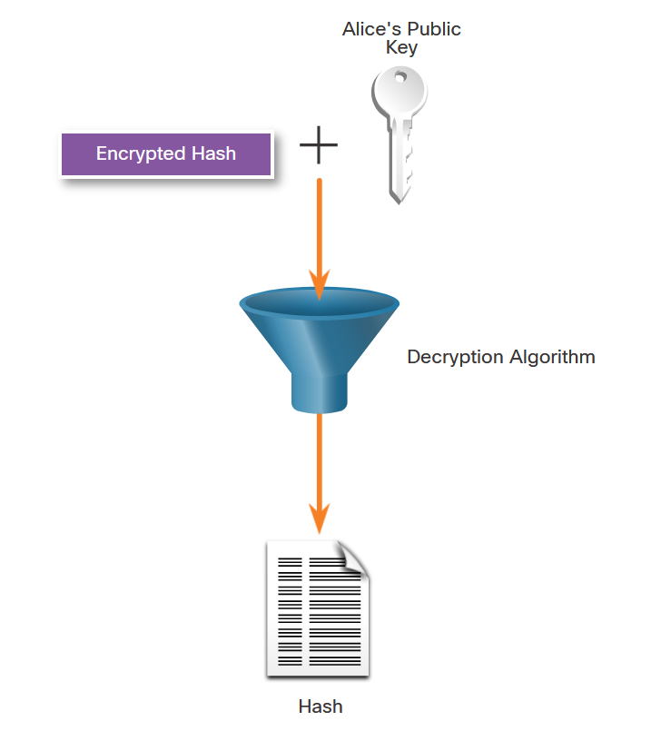
Confidentiality
Asymmetric Encryption – Integrity (Cont.)
Bob uses Alice’s public key to verify that the message was not modified. The received hash is equal to the locally determined hash based on Alice’s public key. Additionally, this verifies that Alice is definitely the sender of the message because nobody else has Alice’s private key.
Bob uses his private key to decipher the message.
Notes:
16: Basic Integrity and Authenticity 16.3: Confidentiality 16.3.6: Asymmetric Encryption - Integrity

Slide 50
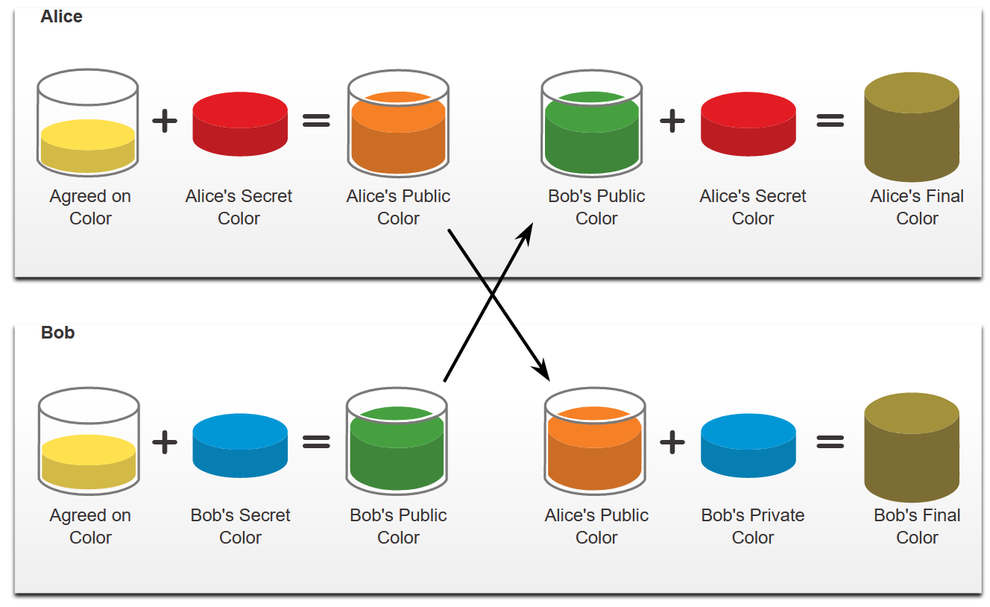
Confidentiality
Diffie-Hellman
Diffie-Hellman (DH) is an asymmetric mathematical algorithm that allows two computers to generate an identical shared secret without having communicated before. The new shared key is never actually exchanged between the sender and receiver. However, because both parties know it, the key can be used by an encryption algorithm to encrypt traffic between the two systems.
Here are two examples of instances when DH is commonly used:
Data is exchanged using an IPsec VPN
SSH data is exchanged
To help illustrate how DH operates, refer to the figure. The colors in the figure will be used instead of complex long numbers to simplify the DH key agreement process.
Diffie-Hellman na youtube
https://youtu.be/KXq065YrpiU?si=MND0B2hakoT-fqAN
Notes:
16: Basic Integrity and Authenticity 16.3: Confidentiality 16.3.7: Diffie-Hellman

Slide 51
Confidentiality
Diffie-Hellman (Cont.)
Diffie-Hellman uses different DH groups to determine the strength of the key that is used in the key agreement process. The higher group numbers are more secure but require additional time to compute the key.
The following identifies the DH groups supported by Cisco IOS Software and their associated prime number value:
DH Group 1: 768 bits
DH Group 2: 1024 bits
DH Group 5: 1536 bits
DH Group 14: 2048 bits
DH Group 15: 3072 bits
DH Group 16: 4096 bits
Notes:
16: Basic Integrity and Authenticity 16.3: Confidentiality 16.3.7: Diffie-Hellman

Slide 52
Module 17: Public Key Cryptography
Instructor Materials
Networking Security v.1
(NETSEC)
Notes:
Networking Security (NETSEC) Module 17: Public Key Cryptography

Slide 53
Module Objectives
Module Title: Public Key Cryptography
Module Objective: Explain how a public key infrastructure is used to ensure data confidentiality and provide authentication.
Topic Title | Topic Objective
Public Key Cryptography with Digital Signatures | Explain public key cryptography.
Authorities and the PKI Trust System | Explain how the public key infrastructure functions.
Applications and Impacts of Cryptography | Explain how the use of cryptography affects cybersecurity operations.
Notes:
53
17 – Public Key Cryptography
17.0.2 – What will I learn to do in this module?

Slide 54
17.1 Public Key Cryptography with Digital Signatures
Notes:
17: Public Key Cryptography 17.1: Public Key Cryptography with Digital Signatures

Slide 55
Public Key Cryptography
Digital Signature Overview
Digital signatures are a mathematical technique used to provide authenticity, integrity, and nonrepudiation.
The following are characteristics of digital signatures:
Authentic - The signature cannot be forged and provides proof that the signer, and no one else, signed the document.
Unalterable - After a document is signed, it cannot be altered.
Not reusable- The document signature cannot be transferred to another document.
Non-repudiated - The signed document is considered to be the same as a physical document.
Notes:
17: Public Key Cryptography 17.1: Public Key Cryptography with Digital Signatures 17.1.1: Digital Signature Overview

Slide 56
Public Key Cryptography
Digital Signature Overview (Cont.)
Digital signatures are commonly used in the following two situations: code signing and digital certificates.
There are three Digital Signature Standard (DSS) algorithms that are used for generating and verifying digital signatures:
Digital Signature Algorithm (DSA) - DSA is the original standard for generating public and private key pairs, and for generating and verifying digital signatures.
Rivest-Shamir Adelman Algorithm (RSA) - RSA is an asymmetric algorithm that is commonly used for generating and verifying digital signatures.
Elliptic Curve Digital Signature Algorithm (ECDSA) - ECDSA is a newer variant of DSA and provides digital signature authentication and non-repudiation with the added benefits of computational efficiency, small signature sizes, and minimal bandwidth.
Notes:
17: Public Key Cryptography 17.1: Public Key Cryptography with Digital Signatures 17.1.1: Digital Signature Overview

Slide 57
Public Key Cryptography
Digital Signatures for Code Signing
Executable files are wrapped in a digitally signed envelope, which allows the end user to verify the signature before installing the software.
Digitally signing code provides several assurances about the code.
The code is authentic and is actually sourced by the publisher.
The code has not been modified since it left the software publisher.
The publisher undeniably published the code. This provides nonrepudiation of the act of publishing.
Notes:
17: Public Key Cryptography 17.1: Public Key Cryptography with Digital Signatures 17.1.2: Digital Signatures for Code Signing

Slide 58
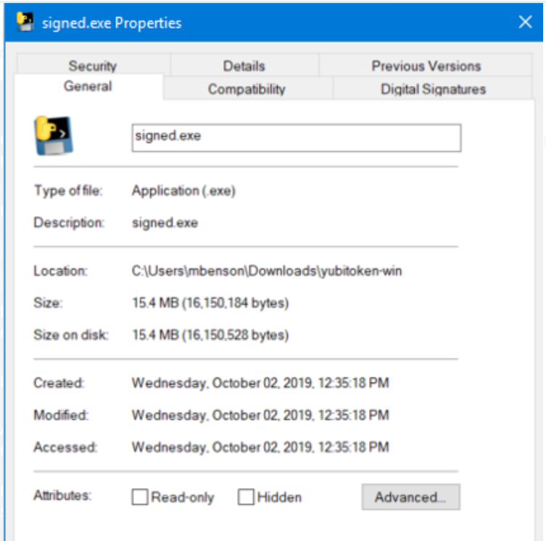
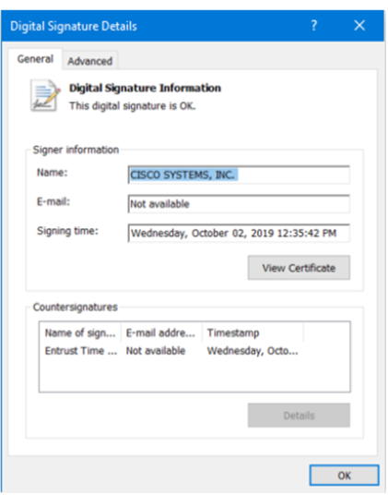
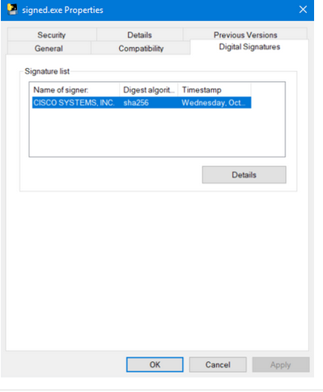
Public Key Cryptography
Digital Signatures for Code Signing (Cont.)
This executable file was downloaded from the internet. The file contains a software tool from Cisco Systems.
Clicking the Digital Signatures tab reveals that the file is from a trusted organization, Cisco Systems Inc.
The Digital Signature Details window reveals that the file was signed by Cisco Systems, Inc in October of 2019.
Notes:
17: Public Key Cryptography 17.1: Public Key Cryptography with Digital Signatures 17.1.2: Digital Signatures for Code Signing

Slide 59
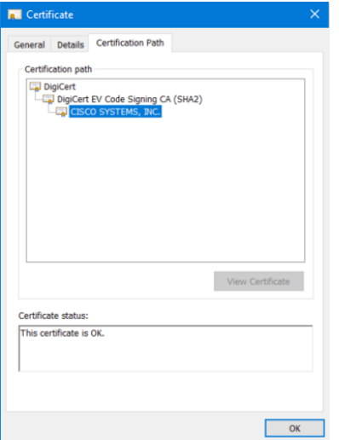
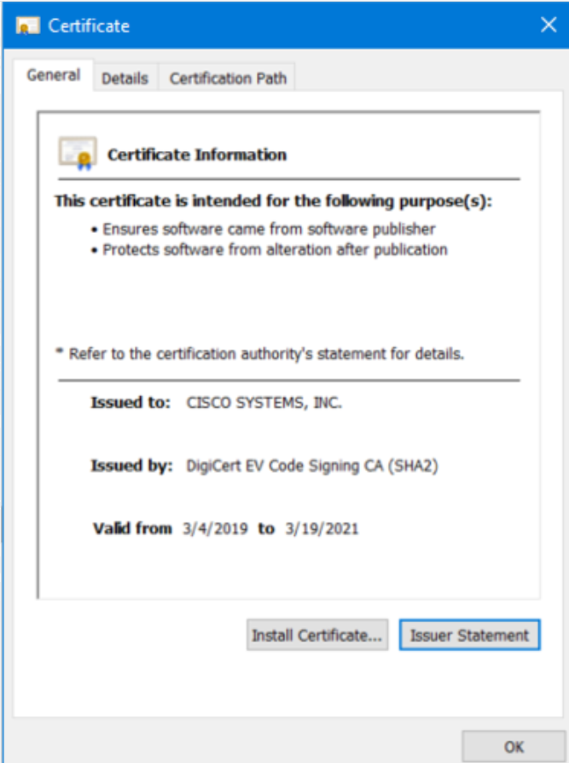
Public Key Cryptography
Digital Signatures for Code Signing (Cont.)
The Certificate Information tab provides the purposes of the certificate, who the certificate was issued to, and who issued the certificate. It also displays the period for which the certificate is valid.
The Certification Path tab to see the file was signed by Cisco Systems, as verified to DigiCert.
Notes:
17: Public Key Cryptography 17.1: Public Key Cryptography with Digital Signatures 17.1.2: Digital Signatures for Code Signing

Slide 60
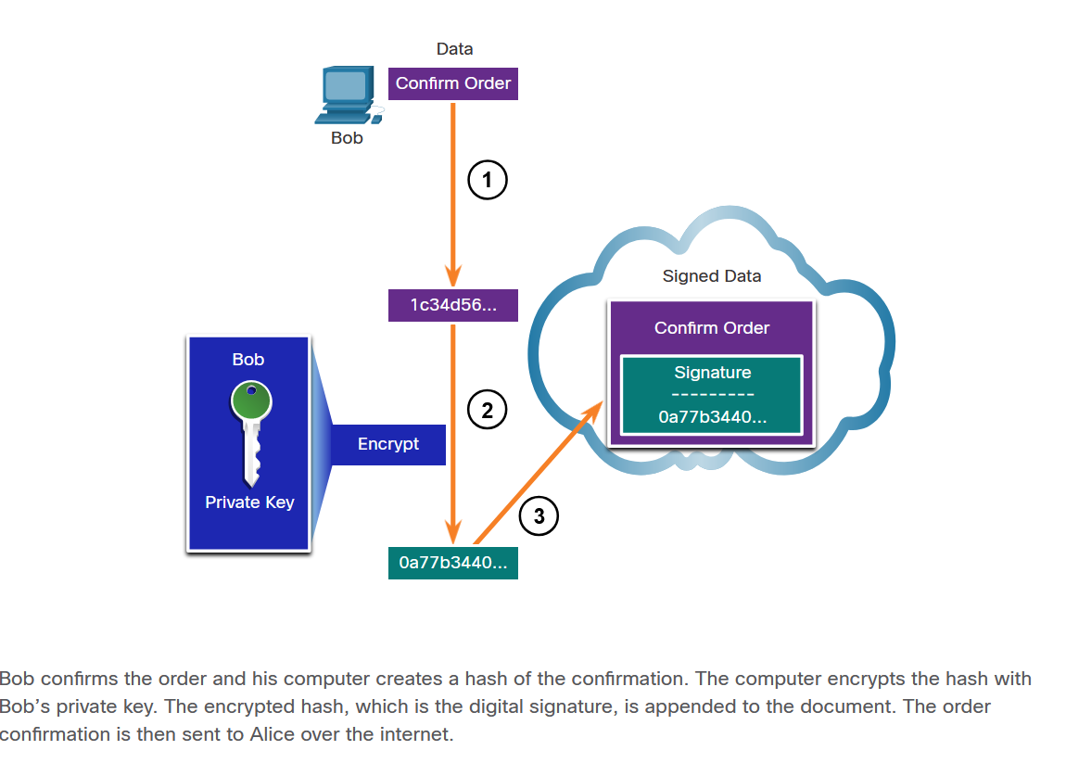
Public Key Cryptography
Digital Signatures for Digital Certificates
A digital certificate is used to authenticate and verify that a user who is sending a message is who they claim to be. Digital certificates can also be used to provide confidentiality for the receiver with the means to encrypt a reply.
This scenario will help you understand how a digital signature is used. Bob is confirming an order with Alice. Alice is ordering from Bob’s website. Alice has connected with Bob’s website, and after the certificate has been verified, the Bob’s certificate is stored on Alice’s website. The certificate contains Bob’s public key. The public key is used to verify the Bob’s digital signature.
Notes:
17: Public Key Cryptography 17.1: Public Key Cryptography with Digital Signatures 17.1.3: Digital Signatures for Digital Certificates

Slide 61
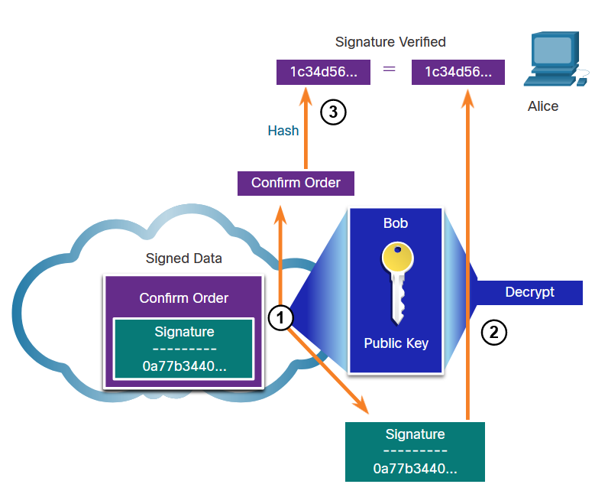
Public Key Cryptography
Digital Signatures for Digital Certificates (Cont.)
When Alice receives the digital signature, the following process occurs:
Alice’s receiving device accepts the order confirmation with the digital signature and obtains Bob’s public key.
Alice’s computer then decrypts the signature using Bob’s public key. This step reveals the assumed hash value of the sending device.
Alice’s computer creates a hash of the received document, without its signature, and compares this hash to the decrypted signature hash. If the hashes match, the document is authentic.
Notes:
17: Public Key Cryptography 17.1: Public Key Cryptography with Digital Signatures 17.1.3: Digital Signatures for Digital Certificates

Slide 62
17.2 Authorities and the PKI Trust System
Notes:
17: Public Key Cryptography 17.2: Authorities and the PKI Trust System

Slide 63
Public Key Cryptography
Public Key Management
When establishing an asymmetric connection between two hosts, the hosts will exchange their public key information.
An SSL certificate is a digital certificate that confirms the identity of a website domain. To implement SSL on your website, you purchase an SSL certificate for your domain from an SSL Certificate provider.
The trusted third party does an in-depth investigation prior to the issuance of credentials. After this in-depth investigation, the third-party issues credentials (i.e., digital certificate) that are difficult to forge. From that point forward, all individuals who trust the third party simply accept the credentials that the third-party issues.
Some examples of Certificate Authorities (CAs) are IdenTrust, DigiCert, Sectigo, GlobalSign, and GoDaddy. These CAs charge for their services. Let’s Encrypt is a non-profit CA that offers certificates free of charge.
Notes:
17: Public Key Cryptography 17.2: Authorities and the PKI Trust System 17.2.1: Public Key Management

Slide 64
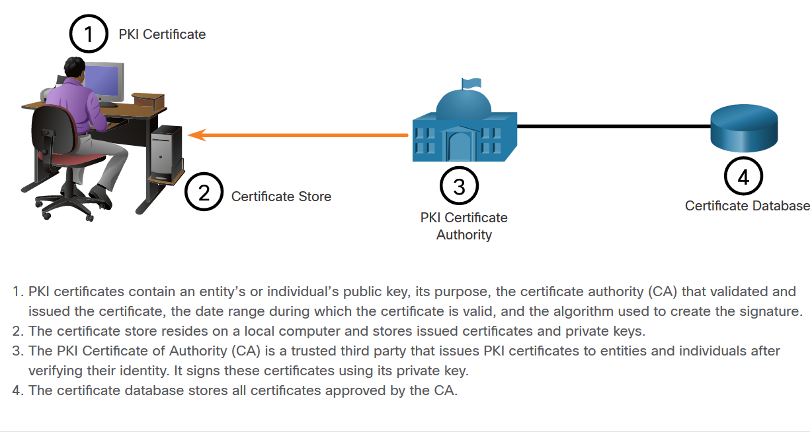
Public Key Cryptography
Public Key Infrastructure
PKI is needed to support large-scale distribution and identification of public encryption keys. The figure shows the main elements of the PKI.
Notes:
17: Public Key Cryptography 17.2: Authorities and the PKI Trust 17.2.2: Public Key Infrastructure

Slide 65
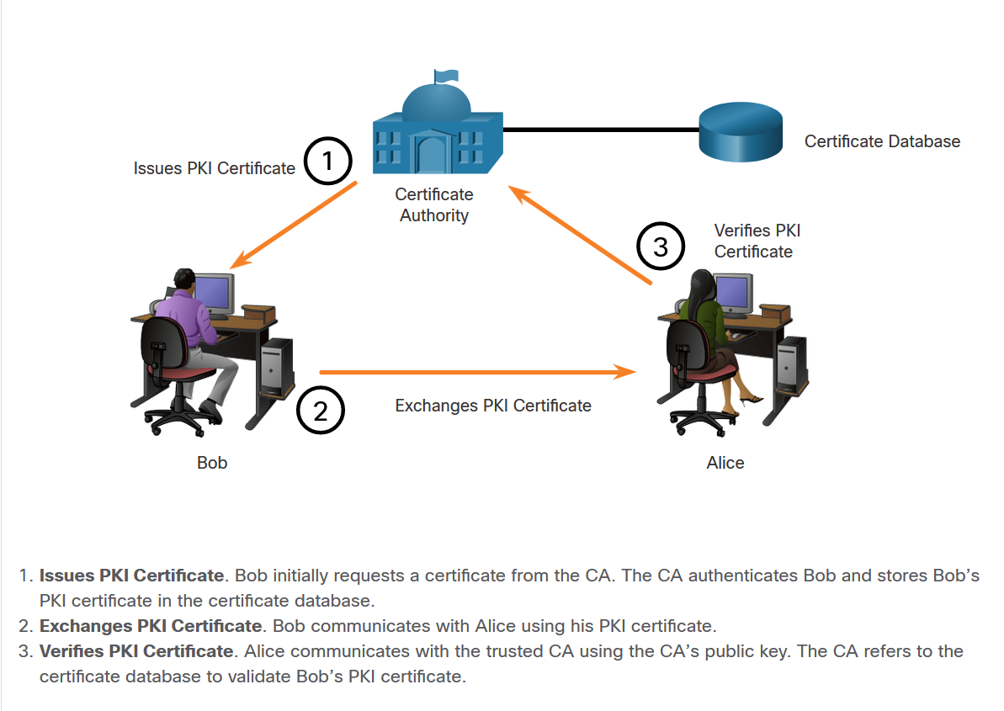
Public Key Cryptography
Public Key Management (Cont.)
The next figure shows how the elements of the PKI interoperate:
In this example, Bob has received his digital certificate from the CA. This certificate is used whenever Bob communicates with other parties.
Bob communicates with Alice.
When Alice receives Bob’s digital certificate, she communicates with the trusted CA to validate Bob’s identity.
Notes:
17: Public Key Cryptography 17.2: Authorities and the PKI Trust System 17.2.2: Public Key Infrastructure

Slide 66
Public Key Cryptography
The PKI Authorities System
CAs, especially those that are outsourced, issue certificates based on classes which determine how trusted a certificate is.
The table provides a description of the classes. The class number is determined by how rigorous the procedure was that verified the identity of the holder when the certificate was issued. The higher the class number, the more trusted the certificate.
Class | Description
0 | Used for testing in situations in which no checks have been performed.
1 | Used by individuals who require verification of email.
2 | Used by organizations for which proof of identity is required.
3 | Used for servers and software signing. Independent verification and checking of identity and authority is done by the certificate authority.
4 | Used for online business transactions between companies.
5 | Used for private organizations or government security.
Notes:
17: Public Key Cryptography 17.2: Authorities and the PKI Trust System 17.2.2: The PKI Authorities System

Slide 67
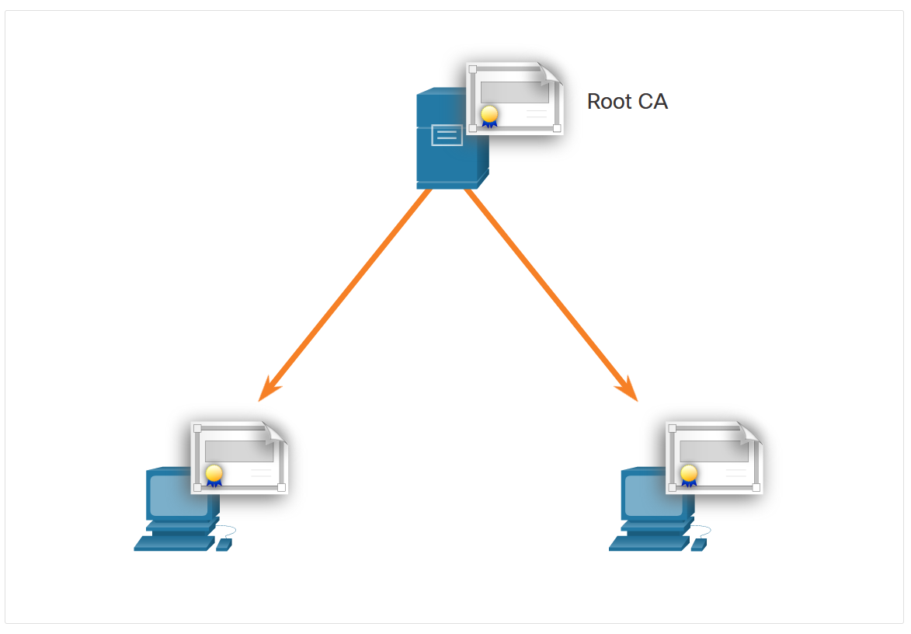
Public Key Cryptography
The PKI Trust System
PKIs can form different topologies of trust. The simplest is the single-root PKI topology.
As shown in the figure, a single CA, called the root CA, issues all the certificates to the end users, which are usually within the same organization. The benefit to this approach is its simplicity. However, it is difficult to scale to a large environment because it requires a strictly centralized administration, which creates a single point of failure.
Notes:
17: Public Key Cryptography 17.2: Authorities and the PKI Trust System 17.2.4: The PKI Trust System

Slide 68
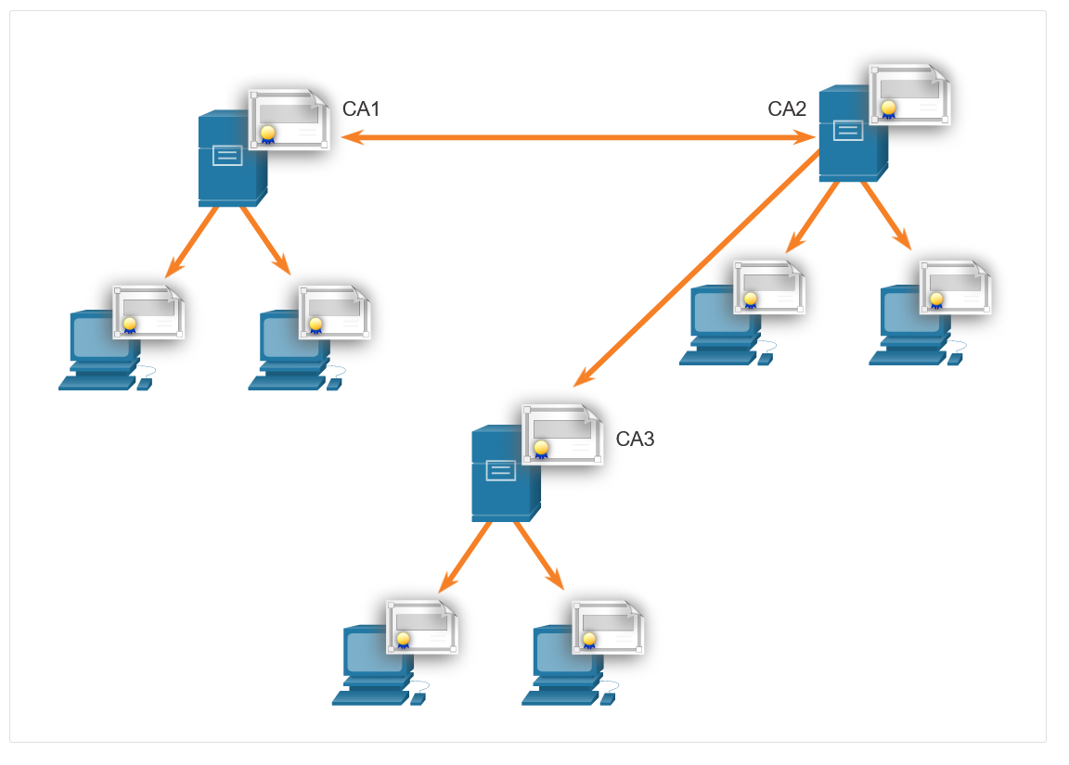
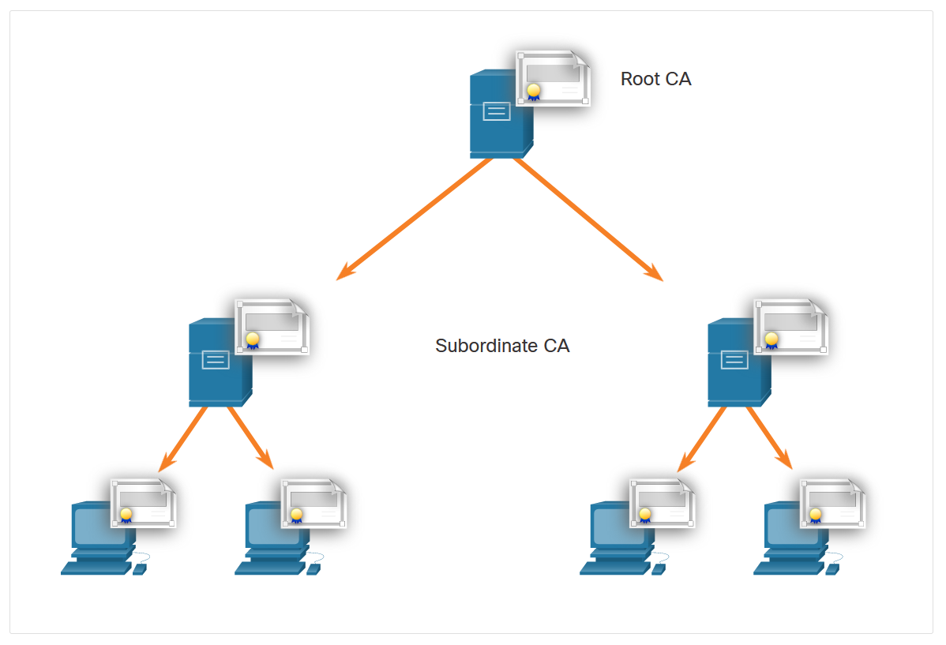
Public Key Cryptography
The PKI Trust System (Cont.)
On larger networks, PKI CAs may be linked using two basic architectures:
Cross-certified CA topologies
Hierarchical CA topologies
Cross-certified CA
Hierarchical CA
Notes:
17: Public Key Cryptography 17.2: Authorities and the PKI Trust System 17.2.4: The PKI Trust System

Slide 69
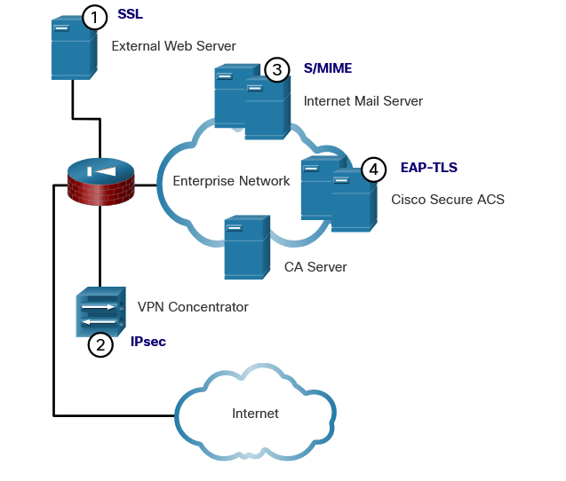
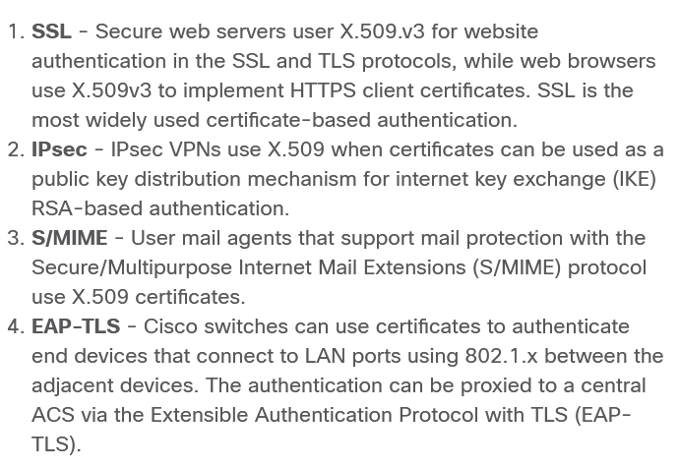
Public Key Cryptography
Interoperability of Different PKI Vendors
Interoperability between a PKI and its supporting services, such as Lightweight Directory Access Protocol (LDAP) and X.500 directories, is a concern because many CA vendors have proposed and implemented proprietary solutions instead of waiting for standards to develop.
To address this interoperability concern, the IETF published the Internet X.509 Public Key Infrastructure Certificate Policy and Certification Practices Framework (RFC 2527). The X.509 version 3 (X.509 v3) standard defines the format of a digital certificate.
Notes:
17: Public Key Cryptography 17.2: Authorities and the PKI Trust System 17.2.5: Interoperability of Different PKI Vendors

Slide 70
Public Key Cryptography
Certificate Enrollment, Authentication, and Revocation
All systems that leverage the PKI must have the CA’s public key, which is called the self-signed certificate. The CA public key verifies all the certificates issued by the CA and is vital for the proper operation of the PKI.
For many systems such as web browsers, the distribution of CA certificates is handled automatically.
The certificate enrollment process is used by a host system to enroll with a PKI. To do so, CA certificates are retrieved in-band over a network, and the authentication is done out-of-band (OOB) using the telephone.
Authentication no longer requires the presence of the CA server, and each user exchanges their certificates containing public keys.
Certificates must sometimes be revoked. The two of the most common methods of revocation are Certificate Revocation List (CRL) and Online Certificate Status Protocol (OCSP).
Notes:
17: Public Key Cryptography 17.2: Authorities and the PKI Trust System 17.2.6: Certificate Enrollment, Authentication, and Revocation

Slide 71
17.3 Applications and Impacts of Cryptography
Notes:
17: Public Key Cryptography 17.3: Applications and Impacts of Cryptography

Slide 72
Applications and Impacts of Cryptography
PKI Applications
Where can PKI be used by an enterprise? The following provides a short list of common uses of PKIs:
SSL/TLS certificate-based peer authentication https://youtu.be/j9QmMEWmcfo?si=l5j4fgUlFP_-6CXN (činnosť TLS )
Secure network traffic using IPsec VPNs
HTTPS Web traffic
Control access to the network using 802.1x authentication
Secure email using the S/MIME protocol
Secure instant messaging
Approve and authorize applications with Code Signing
Protect user data with the Encryption File System (EFS)
Implement two-factor authentication with smart cards
Securing USB storage devices
Notes:
17: Public Key Cryptography 17.3: Applications and Impacts of Cryptography 17.3.1: PKI Applications

Slide 73
Applications and Impacts of Cryptography
Encrypted Network Transactions
Threat actors can use SSL/TLS to introduce regulatory compliance violations, viruses, malware, data loss, and intrusion attempts in a network.
Other SSL/TLS-related issues may be associated with validating the certificate of a web server. When this occurs, web browsers will display a security warning. PKI-related issues that are associated with security warnings include:
Validity date range - The X.509v3 certificates specify “not before” and “not after” dates. If the current date is outside the range, the web browser displays a message. Expired certificates may simply be the result of administrator oversight, but they may also reflect more serious conditions.
Signature validation error - If a browser cannot validate the signature on the certificate, there is no assurance that the public key in the certificate is authentic. Signature validation will fail if the root certificate of the CA hierarchy is not available in the browser’s certificate store.
Notes:
17: Public Key Cryptography 17.3: Applications and Impacts of Cryptography 17.3.2: Encrypted Network Transactions

Slide 74
Applications and Impacts of Cryptography
Encryption and Security Monitoring
Network monitoring becomes more challenging when packets are encrypted.
However, the increased use of HTTPS in the enterprise network introduces new challenges. Because HTTPS introduces end-to-end encrypted HTTP traffic (via TLS/SSL), it is not as easy to peek into user traffic.
Here is a list of some of the things that a security analyst could do:
Configure rules to distinguish between SSL and non-SSL traffic, HTTPS and non-HTTPS SSL traffic.
Enhance security through server certificate validation using CRLs and OCSP.
Implement antimalware protection and URL filtering of HTTPS content.
Deploy a Cisco SSL Appliance to decrypt SSL traffic and send it to intrusion prevention system (IPS)
Notes:
17: Public Key Cryptography 17.3: Applications and Impacts of Cryptography 17.3.3: Encryption and Security Monitoring

